Slide 1
Hospital Management Dashboard
Tools Used
Power BI
Power Query
DAX
Data Modelling
Dataset
5 Related Tables
200 Appointments
50 Patients
10 Doctors

Slide 2
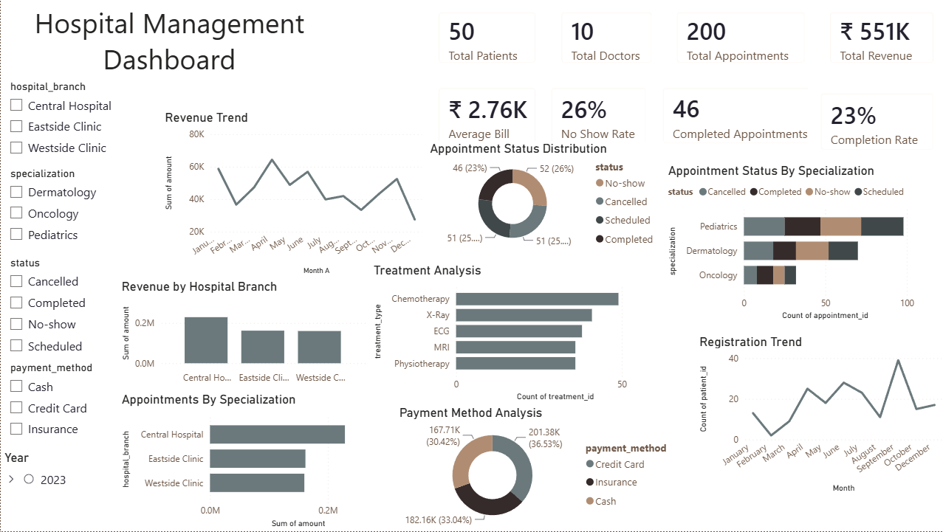
Project overview
Objective
Develop an interactive Hospital Management Dashboard to monitor appointments, revenue, patient registrations, treatments, and hospital performance.
Key Features
Multi-table Data Model
Interactive Slicers
KPI Cards
Revenue Analysis
Appointment Analysis
Treatment Analysis

Slide 3
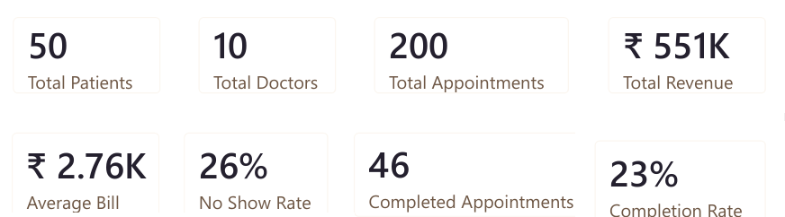
Kpi overview
Key KPIs
Total Patients: 50
Total Doctors: 10
Total Appointments: 200
Total Revenue: ₹551K
Average Bill: ₹2.76K
Completion Rate: 23%
No-show Rate: 26%

Slide 4
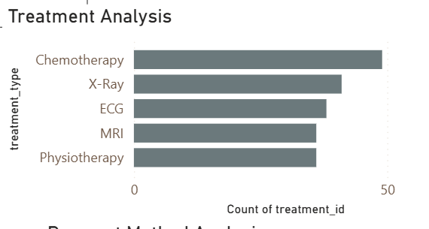
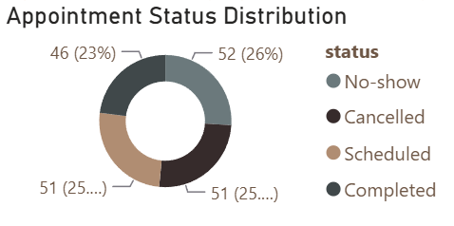
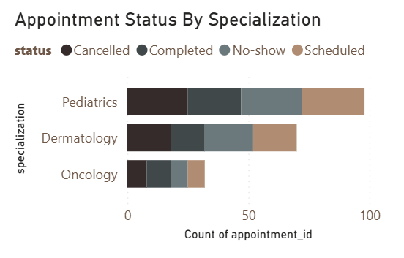
Operational analysis
Insights
Completed appointments account for 23% of all appointments.
No-show appointments contribute significantly to operational inefficiency.
Chemotherapy is the most frequently performed treatment.
Pediatrics receives the highest number of appointments.

Slide 5
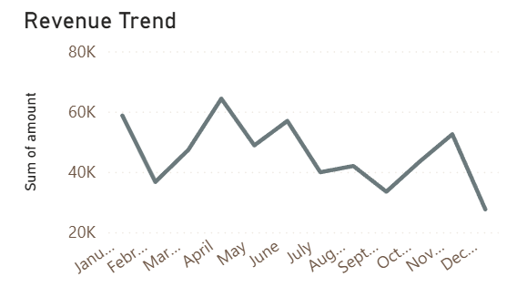
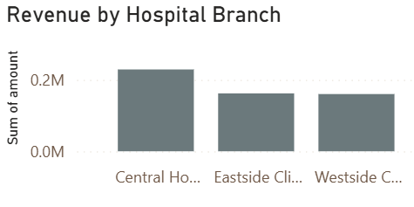
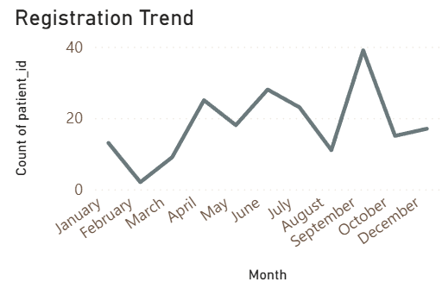
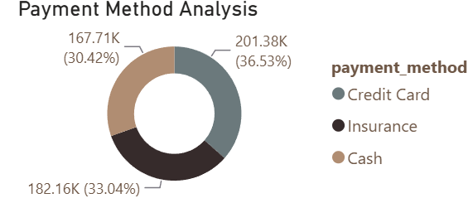
Revenue Analysis
Insights
Central Hospital generates the highest revenue.
Credit Card is the most preferred payment method.
Patient registrations fluctuate across months.
Revenue shows varying monthly performance.

Slide 6
Conclusion & Recommendations
Key Findings
Monitor and reduce no-show appointments through reminder systems.
Allocate resources based on department appointment volume.
Focus on high-performing hospital branches.
Optimize staffing using appointment trends.
Improve revenue tracking through payment method analysis.
Skills Demonstrated
Power Query
Data Modelling
DAX Measures
KPI Design
Interactive Dashboard Development
Business Insights

